Slide 1
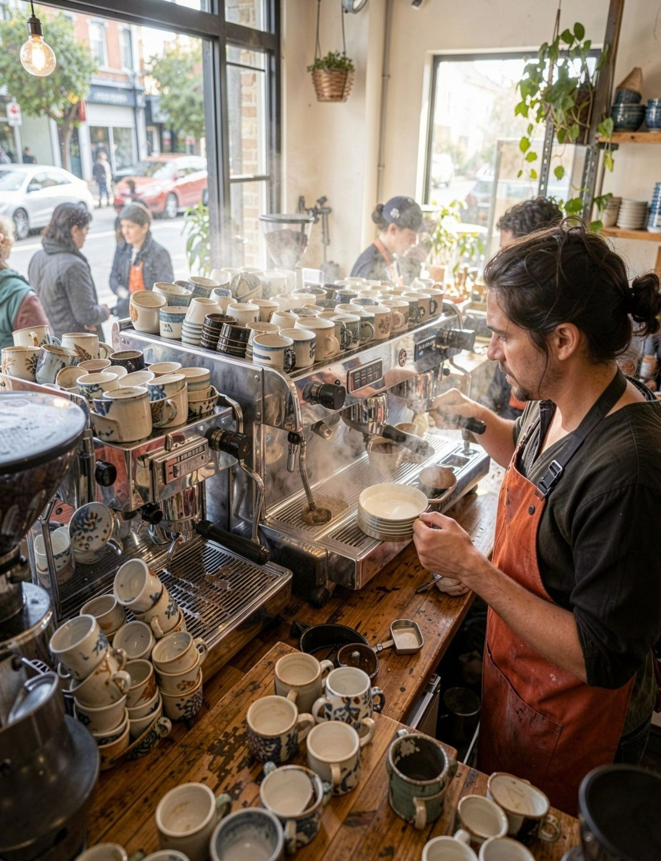
BRIGHT COFFEE SHOP
Sales Performance
& Business Growth
OPPORTUNITIES
From sales data to strategic decisions
JANUARY – JUNE 2023
CEO & SENIOR MANAGEMENT
PERFORMANCE • INSIGHTS • ACTION

Slide 2
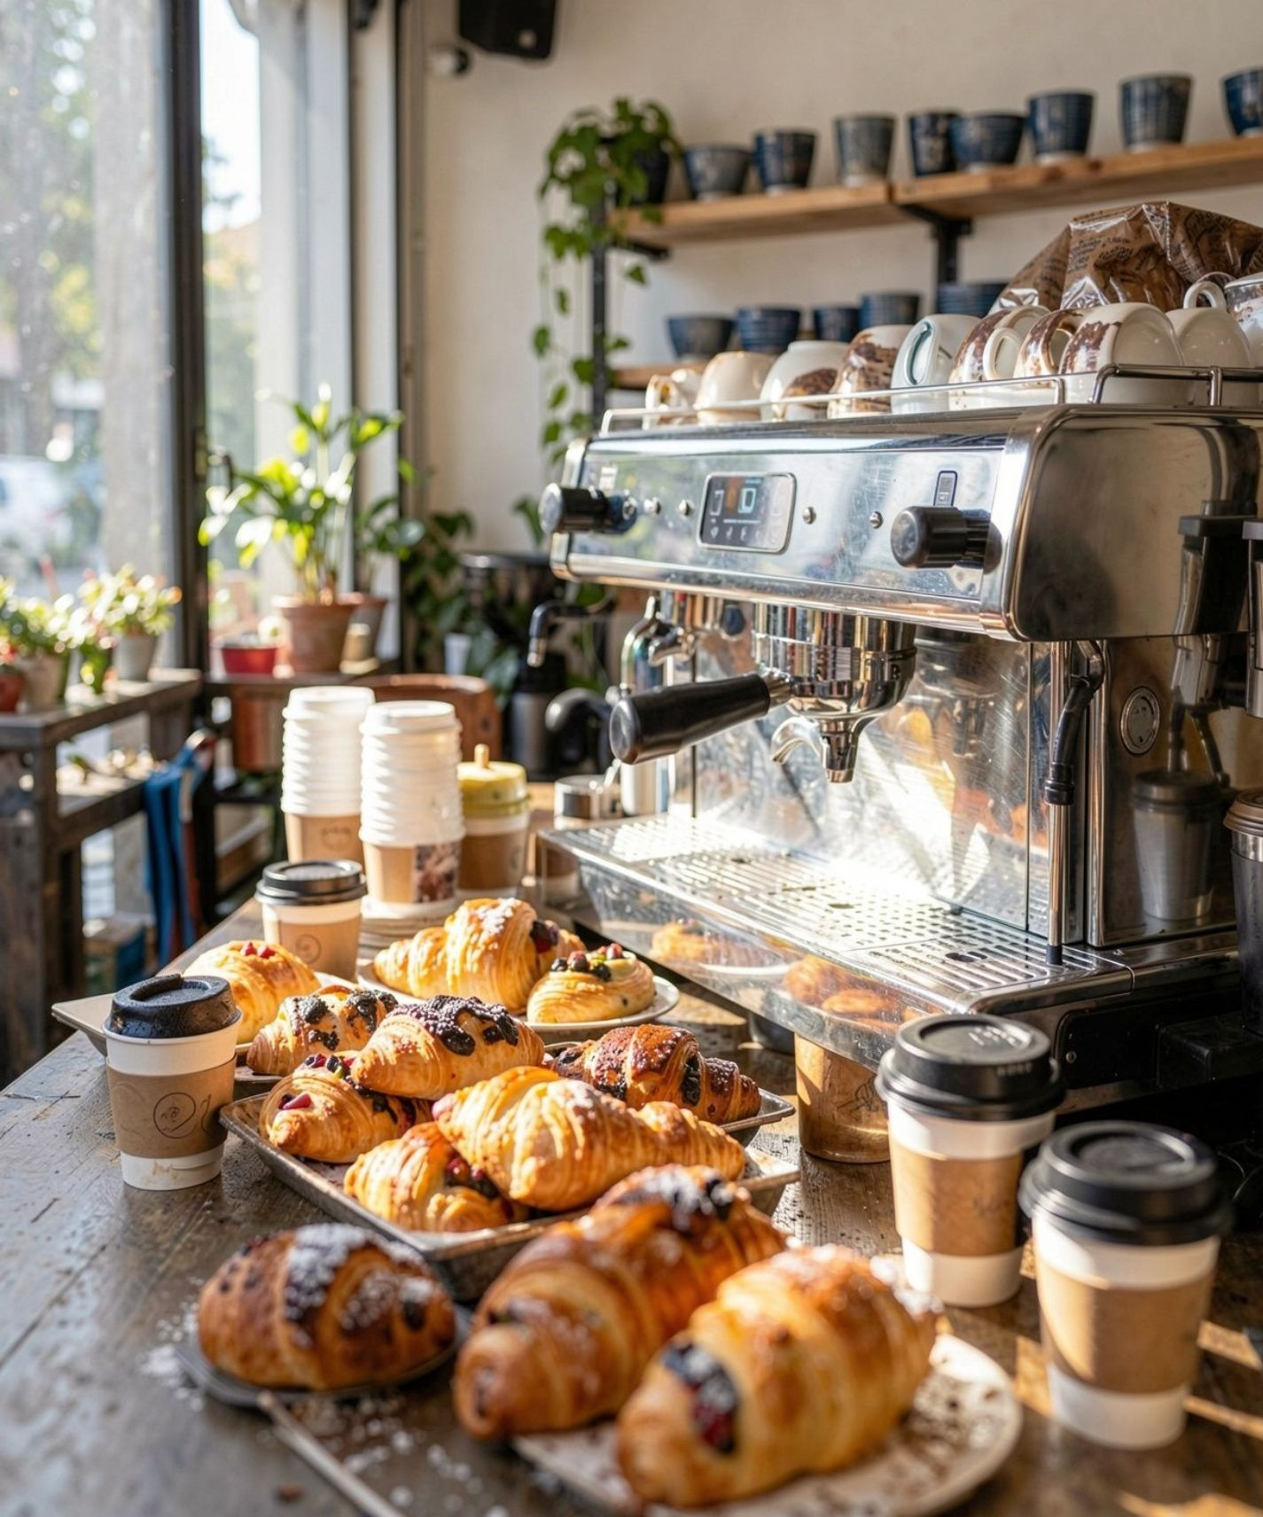
01 / CONTEXT
Turning sales data into smarter decisions
Six months of sales performance, with practical actions for managers.
Bright Coffee Shop sells coffee, other drinks and a variety of products. By tracking sales, the business can understand customer preferences, identify best-selling products, monitor revenue and find practical ways to improve and grow.
UNDERSTAND DEMAND
See what customers buy, when they buy and how sales change over time.
01
PROTECT CORE PRODUCTS
Keep popular categories available and make sensible decisions about slower sellers.
02
TURN INSIGHTS INTO ACTION
Use store and time-of-day patterns to guide stock, staffing and small experiments.
03
GOOD COFFEE. BETTER DECISIONS.
BRIGHT COFFEE SHOP / SALES PERFORMANCE
02

Slide 3
02 / SIZE OF THE BUSINESS
Business at a glance
January–June 2023 • A compact view of the operating scale.
TOTAL REVENUE
UNITS SOLD
TRANSACTIONS
$698,812.33
214,470
149,116
Across six months
Across 80 products
Recorded purchases
AVERAGE TRANSACTION VALUE
PRODUCT RANGE
STORE FOOTPRINT
$4.69
80 products
3 stores • 9 categories
An opportunity for add-ons
Products on sale
Sales locations and categories
WHAT THIS MEANS
Bright Coffee Shop recorded nearly 149,000 purchases across three stores. With an average transaction value of $4.69, carefully chosen add-ons and bundles may help lift spend per visit.
BRIGHT COFFEE SHOP / SALES PERFORMANCE
03

Slide 4
03 / MONTHLY SALES
Revenue recovered after February and rose through June
Monthly revenue and unit volume both increased strongly after the February dip.
MONTHLY REVENUE
JUNE PEAK
$166,485.88
$180K
$166.5K
$156.7K
Highest monthly revenue in the period
$135K
$118.9K
$98.8K
$90K
$81.7K
$76.1K
FEBRUARY → JUNE
+118.7%
$45K
Revenue rose from $76,145 to $166,486.
$0K
Jan
Feb
Mar
Apr
May
Jun
Action: review what changed after February, then repeat the practices that supported growth.
BRIGHT COFFEE SHOP / SALES PERFORMANCE
04

Slide 5
04 / PRODUCTS & CATEGORIES
Coffee and Tea lead the product mix
Protect the products customers buy most, and review the long tail before adding new items.
TOP 10 PRODUCTS BY UNITS SOLD
REVENUE SHARE BY CATEGORY
#
PRODUCT
UNITS
Coffee
38.6%
1
Earl Grey Rg
4,708
Tea
28.1%
2
Dark chocolate Lg
4,668
Bakery
11.8%
3
Morning Sunrise Chai Rg
4,643
Drinking Chocolate
10.4%
4
Latte
4,602
5
Peppermint Rg
4,564
Coffee beans
5.7%
6
Columbian Medium Roast Rg
4,547
Branded
1.9%
7
Traditional Blend Chai Rg
4,512
Loose Tea
1.6%
8
Latte Rg
4,497
Flavours
1.2%
9
Our Old Time Diner Blend Sm
4,484
10
Serenity Green Tea Rg
4,477
Packaged Chocolate
0.6%
Coffee + Tea = 66.7% of revenue
BRIGHT COFFEE SHOP / SALES PERFORMANCE
05

Slide 6
05 / STORE RESULTS
Three stores, one consistent performance level
Each location contributes roughly one-third of total revenue.
REVENUE BY STORE
SMALL GAP BETWEEN STORES
Hell's Kitchen
2.8%
$236,511
33.8% of revenue
The difference between the highest and lowest store is about 2.8% relative to the lower store.
Astoria
$232,244
33.2% of revenue
STORE COMPARISON
Lower Manhattan
Hell's Kitchen
71,737 units
$230,057
32.9% of revenue
Astoria
70,991 units
Lower Manhattan
71,742 units
Manager focus: share effective practices and investigate local differences without overreacting to small gaps.
BRIGHT COFFEE SHOP / SALES PERFORMANCE
06

Slide 7
06 / SALES FINDINGS
Sales are steady across the week; weekdays drive most revenue
Weekday activity contributes about 72% of six-month revenue.
REVENUE BY DAY OF WEEK
WEEKDAY REVENUE
110K
72.1%
$101.7K
$99.5K
$100.3K
$100.8K
$101.4K
$96.9K
$98.3K
82K
$503,588
55K
WEEKEND REVENUE
28K
27.9%
0K
Mon
Tue
Wed
Thu
Fri
Sat
Sun
$195,225
Planning cue: align stock and staffing to weekday demand while continuing to monitor weekend patterns.
BRIGHT COFFEE SHOP / SALES PERFORMANCE
07

Slide 8
07 / TIME OF DAY
Morning is the clearest sales peak
More than half of revenue is generated before midday.
REVENUE BY TIME OF DAY
MORNING
55.6%
Morning
55.6%
$388,289
117,629 units
$388.3K in revenue from 117,629 units sold.
Afternoon
35.0%
$244,855
76,540 units
EVENING OPPORTUNITY
Evening
9.4%
9.4%
$65,669
20,301 units
Evenings contribute $65.7K and 20,301 units. Test one small promotion or operating change, then compare results.
BRIGHT COFFEE SHOP / SALES PERFORMANCE
08

Slide 9
08 / INSIGHTS SUMMARY
Four findings to guide the next decisions
The goal is to repeat what works and test opportunities carefully.
01
SALES GROWTH
02
CORE CATEGORIES
Revenue rose from $76.1K in February to $166.5K in June — an increase of about 119%.
Coffee and Tea generated 66.7% of revenue, led by Coffee at $270.0K and Tea at $196.4K.
NEXT STEP
Investigate the February dip, then document the practices that supported recovery.
NEXT STEP
Protect availability of core items and consider relevant add-ons.
03
BALANCED STORES
04
EVENING SALES
Each store contributed roughly one-third of revenue; the highest and lowest stores are close in scale.
Evening sales were 9.4% of revenue, compared with 55.6% in the morning.
NEXT STEP
Share good practices while watching for local needs.
NEXT STEP
Run a small, measurable evening test before making larger changes.
BRIGHT COFFEE SHOP / SALES PERFORMANCE
09

Slide 10

09 / RECOMMENDATIONS
Five practical actions for the next operating cycle
Each action is tied to a pattern in the January–June sales data.
01
PROTECT CORE STOCK
Keep Coffee and Tea reliably in stock; together they account for 66.7% of revenue.
02
TEST AN EVENING OFFER
Pilot one promotion or bundle in the evening, when sales account for 9.4% of revenue.
03
SHARE STORE PRACTICES
Compare how the three stores operate and share effective approaches without overreacting to small revenue gaps.
PLAN FOR PEAK DEMAND
Prioritise staffing and stock for weekday mornings, when customer activity and revenue are highest.
04
A SIMPLE REVIEW RHYTHM
05
REVIEW AND LEARN MONTHLY
Investigate the February dip, track each test, and compare results before repeating or scaling changes.
Measure
Test
Compare
Repeat what works
BRIGHT COFFEE SHOP / SALES PERFORMANCE
10

Slide 11
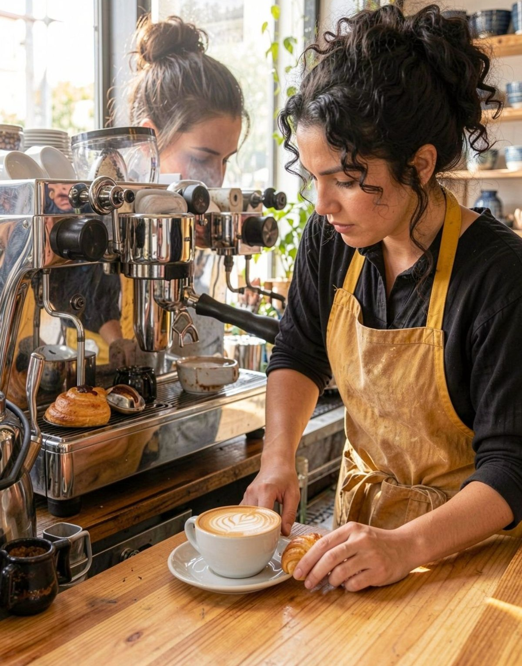
BC
Thank You
Questions & discussion
Protect what works. Test what could be better.
Use the results to make the next decision.
BRIGHT COFFEE SHOP • JANUARY–JUNE 2023

